Slide 1

Project Deployment
Focused on Mushroom data set

Slide 2
Table of Contents
INTRODUCTION
LOGISTIC REGRESSION MODEL
RANDOM FOREST EVALUATION
RANDOM FOREST DEPLOYMENT
RANDOM FOREST MODEL
HOME PAGE DEPLOYMENT
PROJECT CONCLUSIONS
DATA UNDERSTANDING
LOGISTIC REGRESSION EVALUATION
LOGISTIC REGRESSION DEPLOYMENT
END PAGE
DATA PREPARATION

Slide 3
Introduction
Mushroom poisoning accounts for approximately 70% of natural poisoning and often causes death.
There are only 30–50 poisonous species among the thousands of species found on earth, and of these, no more than 10 are fatally poisonous. Nevertheless, many cases of mushroom poisoning are reported every year.
We tried to create a web-tool that enables the beginner mushroom finders to check if the mushrooms he has picked up are edible or not.

Slide 4
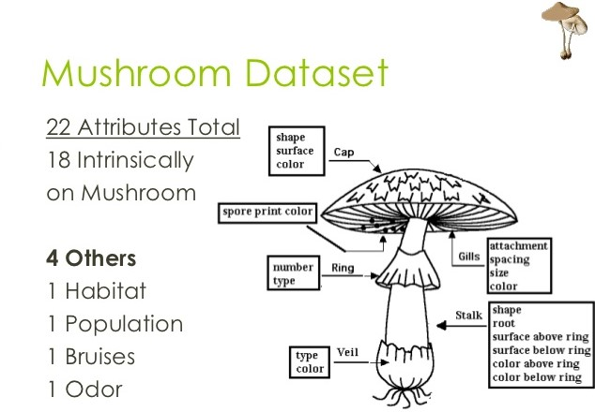
Data Understanding
Our dataset contains 22 total attributes describing mushroom’s shape and aspect, plus an attribute saying if the mushroom is edible or not.

Slide 5
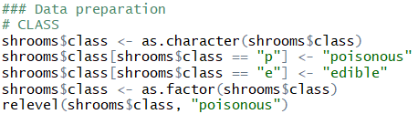
Data Preparation
Since the attributes are expressed in coded symbols, for clarity motivation we have to read the dataset, transform the symbols in strings,cast the strings as factor

Slide 6

Modelling
Logistic Regression Model
Random Forest Model
Since our datas are labeled this is a supervised learning problem.
To make ou tool safer we implemented two different algorithms so the user can double check.
Regression model used in case the predicted variable is dichotomous.
We model this variable (edible/poisonous) through the logit function.
Where p is the probability of the mushroom to be edible.
Is an ensemble tree method for classification We grow many classification trees and then we average the results.

Slide 7


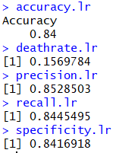
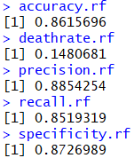
Evaluation
Logistic Regression
Random Forest
For logistic regression, steps to be performed:
Compute the confusion matrix for the logistic regression model.
Calculate the metrics for the confusion matrix, and the death rate.
For random forest, we should follow the same steps as before.
The values for the evaluation parameters are better than before, as they have all improved.

Slide 8
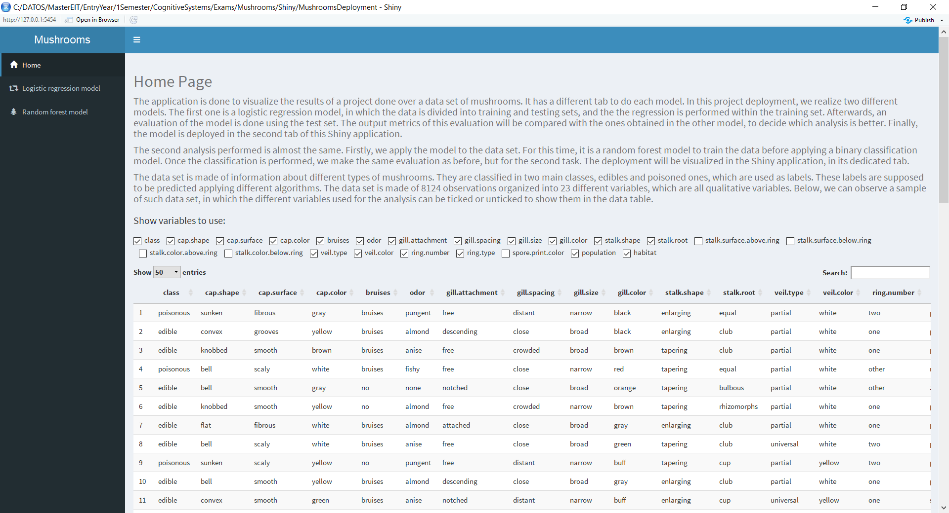
Home Page Deployment
The deployment is done using Shiny visualization tool.
The first tab is dedicated to introduce the project.
Components of the first tab:
Title
HelpText
CheckBox Group Input
DT data table

Slide 9
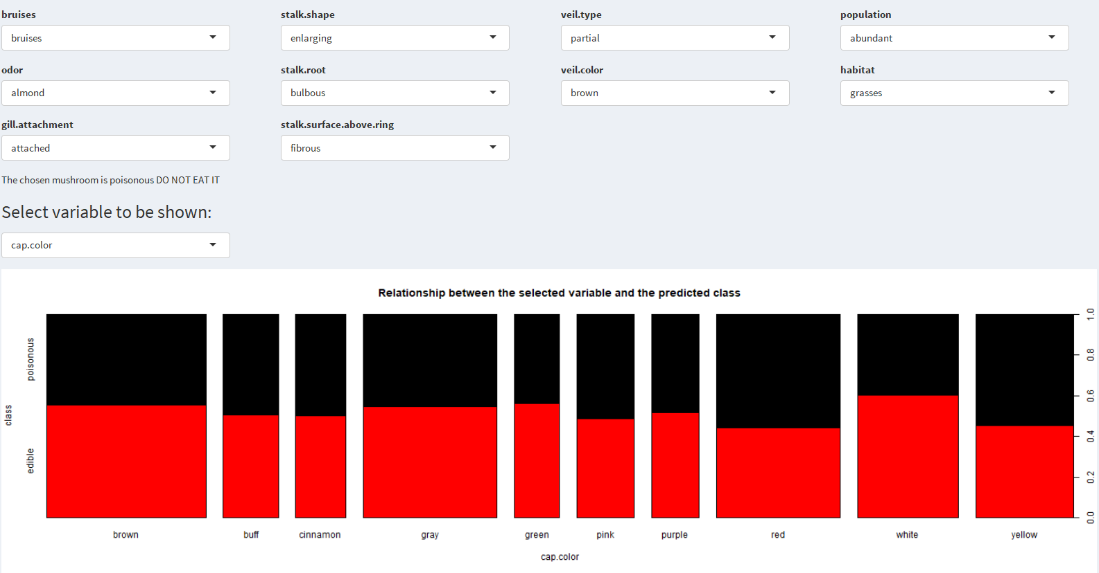
Logistic Regression Deployment
Stored in the second tab of the Shiny app.
It shows two outputs:
A prediction of the class given the variables in select inputs.
The relationship between one of the variables and the predicted outcome.

Slide 10
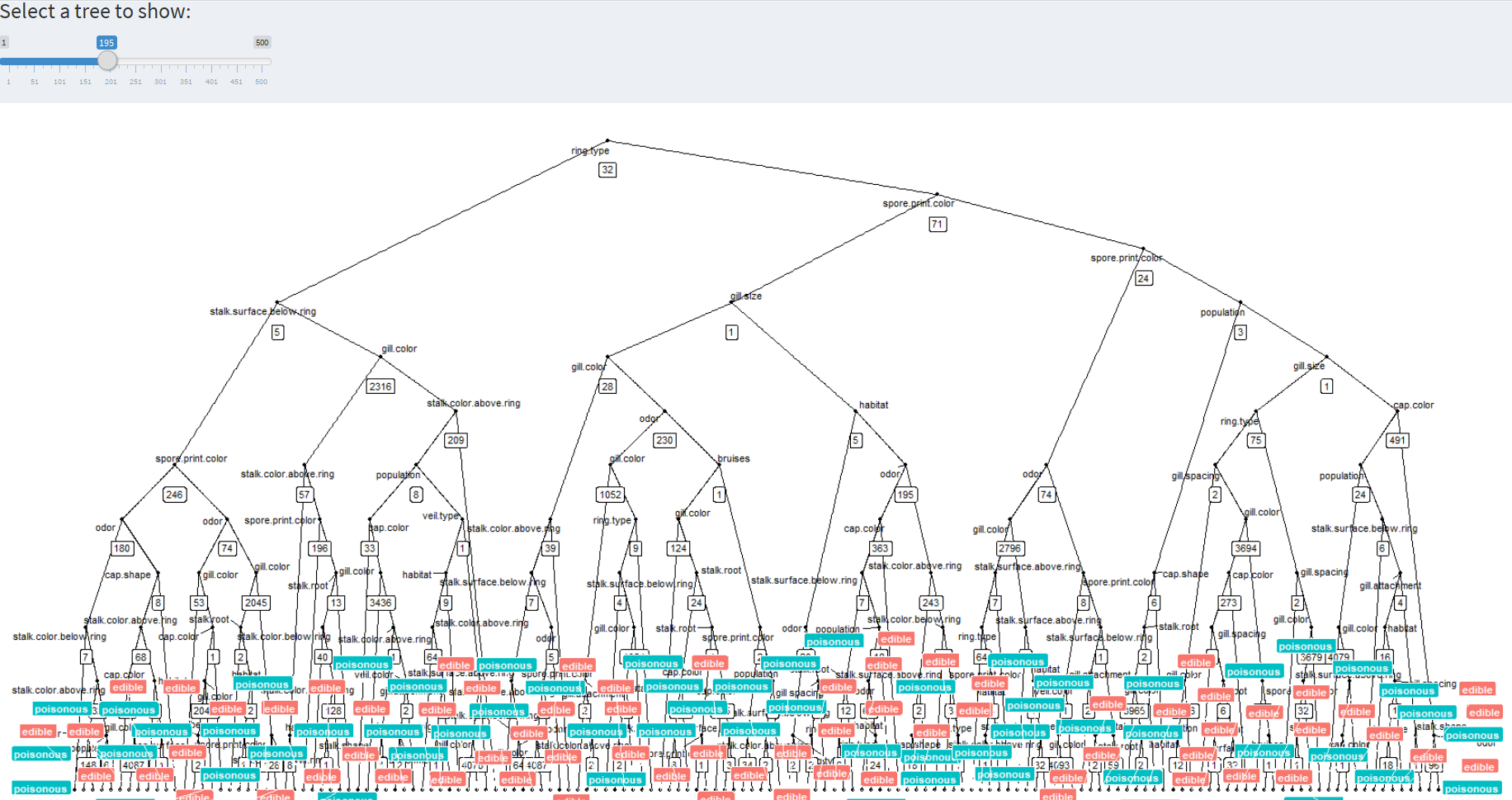
Random Forest Deployment
It is stored in the third tab, and shows two outputs:
Class prediction, using select inputs.
Plot of one of the trees created with the random forest algorithm.
Components of the tab:
22 select inputs for the variables.
A text output for predicting the outcome.
A slider input for deciding which tree is shown.
The actual plot of such tree.

Slide 11
Project Conclusions
There is no selected model, both are valid. If a user performs the analysis with the two models, the death rate decreases from approximately a 15% to a 2.3%.
The death rate, which is the most important metric, is lower in random forest model.
Random forest model leads to better results than logistic regression model.
Logistic regression model is better in terms of time and complexity, as it is easier to implement and has a higher performance.

Slide 12
Thank you!
Lorenzo Foà
José Manuel Pérez

